Slide 1
Amazon Music Clustering
UNSUPERVISED ML · MUSIC ANALYTICS
Millions of songs are too many to tag by hand. I grouped 95,837 songs by how they sound, with no genre labels, using K-Means.
Business use cases
Playlist curation
Song discovery
Artist analysis
Market segmentation
Dewakaran · Final Project
Notes:
TALKING POINTS (about 45 seconds) • Hi, I’m Dewakaran. My project is Amazon Music Clustering. • Problem: platforms like Amazon have millions of songs. Tagging each one by genre by hand is impractical and inconsistent. • Goal: group songs automatically by how they sound, using only audio features such as energy, danceability and acousticness. No genre labels are used, so this is unsupervised learning. • Why it matters: the groups can power playlist curation, “similar song” recommendations, artist competition analysis and listener segmentation. • What I’ll cover: the data and method, how I chose the number of clusters, what the three clusters are, and how good they are. IF ASKED • Supervised vs unsupervised: supervised learns from known answers (labels); unsupervised finds structure with no labels. Clustering is unsupervised. • Clustering = grouping points so items in a group are similar to each other and different from other groups.

Slide 2
A clean dataset and six steps
DATA AND METHOD
95,837
23
10
0
songs
columns in the raw file
audio features used
missing or duplicate rows
01 Explore
02 Select
03 Scale
Nulls, duplicates, histograms, correlations
Keep 10 sound features, drop 13 metadata columns
StandardScaler: mean 0, standard deviation 1
04 Choose k
05 Cluster
06 Interpret
Elbow and silhouette for k = 2 to 10
KMeans(k=3, n_init=10, random_state=42)
Profile, name, plot with PCA, export CSV
Source: single_genre_artists.csv
Notes:
TALKING POINTS (about 1 minute) • Dataset: single_genre_artists.csv, 95,837 songs and 23 columns. No missing values and no duplicates, so no imputation was needed. • I kept 10 features that describe how a song sounds (listed at the bottom). • I dropped 13 columns: IDs and names carry no musical information; popularity and followers describe success, not sound; genres is what we’re trying to discover, so using it would be cheating; key, mode, time_signature and explicit are categorical. • EDA: speechiness, instrumentalness and liveness are heavily right-skewed; acousticness is bimodal; duration goes up to about 80 minutes. Strongest correlations: energy–loudness +0.73, energy–acousticness −0.66, danceability–valence +0.50. • Scaling matters because K-Means uses Euclidean distance. duration_ms is in the hundreds of thousands while most features are 0 to 1, so without StandardScaler duration would decide the clusters on its own. • n_init=10 runs K-Means 10 times from different starting centroids and keeps the best (lowest inertia). random_state=42 makes results reproducible. Initialisation is k-means++, the sklearn default. IF ASKED • Why drop key? It’s 0–11 for C, C#, D… — a category. 11 isn’t “more” than 0, so distance would treat it wrongly. It would need one-hot encoding. • StandardScaler vs MinMaxScaler: MinMax squashes to 0–1 and is pulled by outliers; StandardScaler (z = (x − mean) / std) is the usual choice for K-Means. • How K-Means works: pick k, place centroids, assign each song to the nearest centroid, move centroids to the mean of their songs, repeat until stable. It minimises inertia (sum of squared distances).

Slide 3
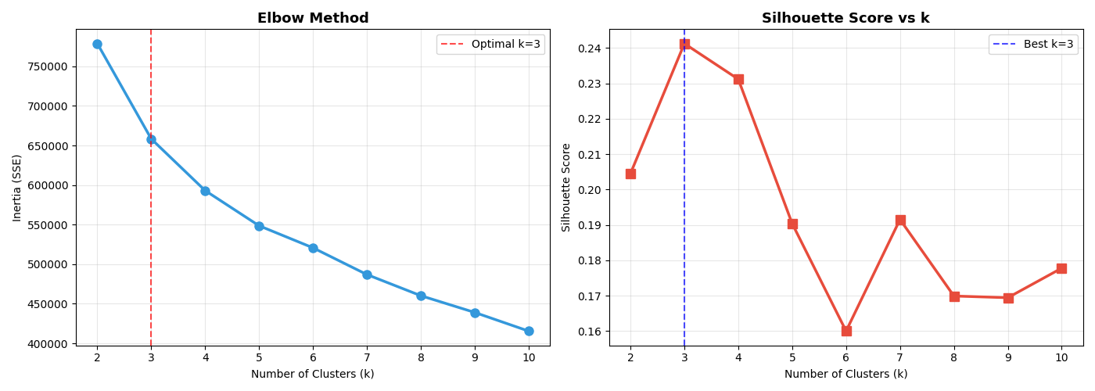
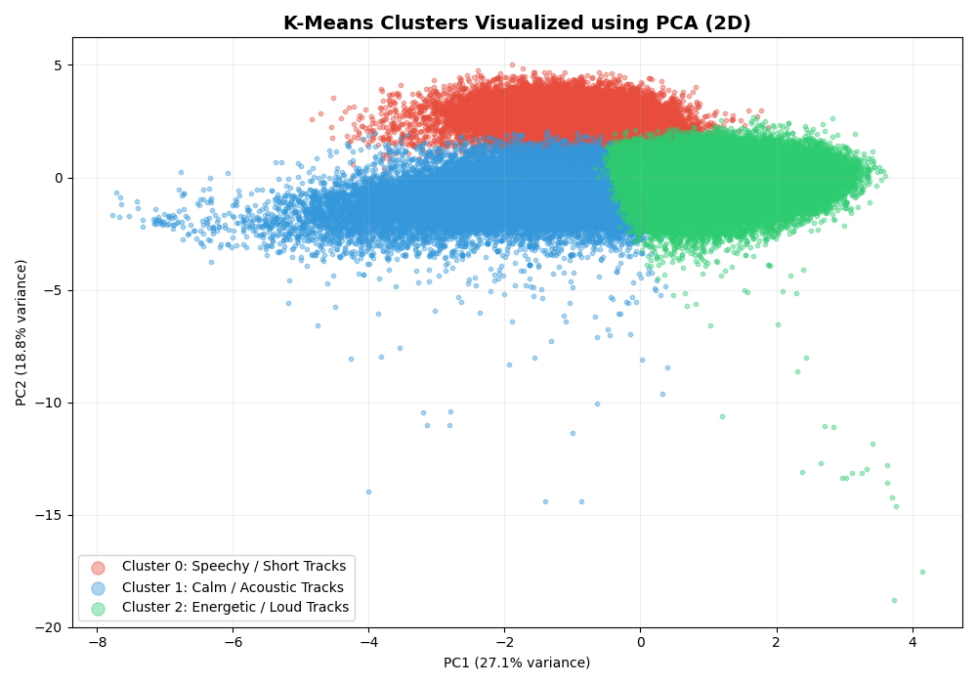
k = 3 wins, and the clusters separate
CHOOSING K
k = 3: 0.241, best
k = 4: 0.231
k = 6: 0.160, lowest
Inertia always falls as k grows and bends gradually, so the silhouette peak decided k.
PCA, for the picture only: PC1 27.1% + PC2 18.8% = 45.9% of variance
Silhouette computed on a 5,000-song random sample
Notes:
TALKING POINTS (about 1 minute) • I ran K-Means for k = 2 to 10 and recorded inertia and silhouette score each time. • Left chart: inertia (elbow) falls steadily with no sharp bend, so the elbow alone is ambiguous. Silhouette peaks clearly at k = 3 (0.241), k = 4 is close (0.231), and it drops to 0.160 at k = 6. So k = 3. • Three groups are also easy for a business audience to use. • Right chart: I used PCA to squeeze 10 dimensions into 2 just to draw the clusters. Red (Cluster 0) sits high, blue (Cluster 1) to the left, green (Cluster 2) to the right. • K-Means ran on all 10 scaled features, not on the PCA output. The 2D view keeps only 45.9% of the variance, so some border overlap is lost information, not bad clustering. IF ASKED • Silhouette: s = (b − a) / max(a, b), where a is the mean distance to your own cluster and b to the nearest other cluster. Range −1 to 1; higher is better. • Why sample_size=5000? Full silhouette compares every pair: about 9 billion distances for 96k songs. A random 5,000 gives a reliable estimate fast. • What PC1/PC2 mean: PC1 mostly contrasts energy/loudness with acousticness; PC2 is driven by speechiness. I’d confirm by printing pca.components_. • Why not t-SNE? Heavier to compute on 96k rows; it could separate clusters better visually and is a next step.

Slide 4
Three clusters, confirmed by genre tags
CLUSTER PROFILES
CLUSTER 0 · 13.1%
CLUSTER 1 · 32.1%
CLUSTER 2 · 54.8%
Speechy / Short
Calm / Acoustic
Energetic / Loud
Speechiness 0.83
Duration ~97 s
Liveness 0.44
Acousticness 0.75
Energy 0.31, the lowest
Loudness −13.2 dB
Energy 0.69
Loudness −7.6 dB
Tempo 125 BPM
Genres: ~76% German audio dramas (hoerspiel), plus poetry
Genres: vintage Taiwan pop, classic Israeli pop, chanson
Genres: J-pop, Turkish pop, rock uruguayo; median year 2000
Mean feature values per cluster · genre column checked only after clustering
Notes:
TALKING POINTS (about 1.5 minutes) • I named each cluster from its average feature values (df.groupby('Cluster').mean()). • Cluster 0, Speechy / Short (12,513 songs): very high speechiness 0.83, shortest tracks at about 97 seconds, highest liveness. • Cluster 1, Calm / Acoustic (30,807): highest acousticness 0.75, lowest energy 0.31, quiet at −13.2 dB. Also the highest instrumentalness (0.17). • Cluster 2, Energetic / Loud (52,517): highest energy 0.69, loudest at −7.6 dB, fastest at 125 BPM, and the happiest (valence 0.67). • Validation, and the key point: I dropped the genre column before training, then checked it afterwards. Cluster 0 is about 76% German audio dramas (hoerspiel and kleine hoerspiel), plus poetry and children’s stories. So it’s really a spoken-word cluster, not rap. Cluster 1 is older soft pop and chanson. Cluster 2 is modern pop and rock, median release year 2000 vs about 1985 for the others. • This matches the brief’s “genre inference” goal: the model found real structure without ever seeing labels. IF ASKED • Why does Cluster 0 have the highest danceability (0.66)? Speech has a steady rhythm that the danceability measure picks up. It’s a side-effect, not dance music. • Why is Cluster 2 so big? Most released music is mainstream, loud and produced. K-Means doesn’t force equal sizes. A higher k would split it into sub-styles. • Heatmap/bar chart caveat: those were scaled 0–1 across the three clusters, so they show ranking, not real values. Cluster 1’s danceability shows 0 there but is really 0.49. • Why not cluster by genre? 3,153 unique, inconsistent genre tags; audio features work for new songs with no tag.

Slide 5
Modest separation, clear and usable groups
RESULTS AND NEXT STEPS
0.2413
1.5702
Cluster size balance
13%
32%
55%
Silhouette (higher better)
Davies-Bouldin (lower better)
How it’s used
Next steps
New song: scaler.transform → kmeans.predict
Recommend nearest songs in the same cluster
Keep audio dramas out of music playlists
Treat outliers and skew (log, capping)
Try DBSCAN and GMM; test a higher k
Streamlit app to explore similar songs
Thank you · Questions?
Notes:
TALKING POINTS (about 1.5 minutes) • Silhouette 0.2413: modest, and I say so honestly. Music doesn’t fall into sharp groups; a pop ballad sits between calm and energetic. 0.2–0.3 is common for real-world data. It’s positive, so songs are on average closer to their own cluster than the next. • Davies-Bouldin 1.57: moderate. Clusters separate but spread at the edges. Below 1 would be strong. • Inertia at k = 3: about 658,335. • Cluster size balance (a brief metric): 13 / 32 / 55%. Uneven because mainstream energetic music dominates; K-Means doesn’t force equal sizes. • Use: a new song is scaled with the same fitted scaler (transform, not fit_transform), assigned with predict, and we recommend its nearest cluster-mates. No retraining needed. Save scaler and model with joblib. • Limitations: outliers not treated (duration up to ~80 min); skewed features get large z-scores; energy and loudness overlap (r = 0.73); k = 3 is coarse for playlists; K-Means assumes round, similar-sized clusters. • Next: log-transform or cap; DBSCAN for noise, GMM for soft membership; higher k; stability check across seeds with Adjusted Rand Index; Streamlit app. • Deliverables: Amazon.py, clustered CSV with Cluster and Cluster_Name, 6 plots, report, this deck. • Close: “Audio features alone split 95,837 songs into spoken word, calm acoustic and energetic music, and genre tags back it up. Thank you, happy to take questions.” IF ASKED • Davies-Bouldin: for each cluster, (its spread + nearest cluster’s spread) / distance between centres, averaged. 0 is perfect. • Why not hierarchical? Memory grows with n², impractical for 96k rows. • Streamlit: it’s an optional bonus in the brief; planned as the next step. • Complexity: roughly n × k × features × iterations, linear in n.

